Slide 1
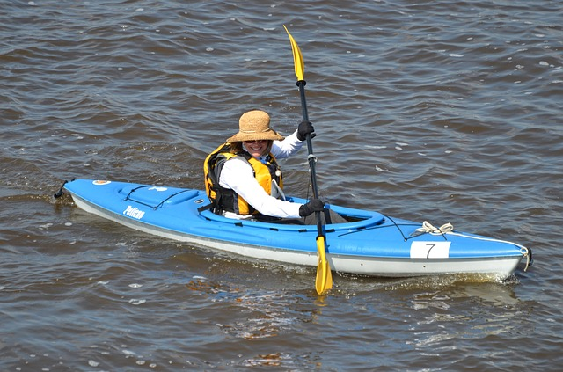
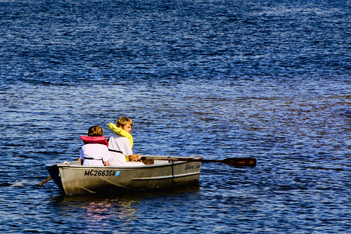
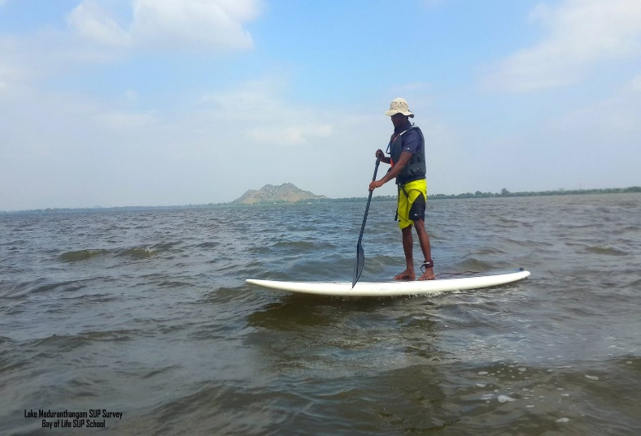
PADDLE CRAFT VESSEL SAFETY CHECK INSTRUCTION GUIDE FOR USPS VESSEL EXAMINERS
Revision 3
September 28, 2020

Slide 2
Paddle Craft Introduction
Paddle Craft vessels include but are not limited to kayaks, canoes, rowboats, stand-up paddleboards, sculls, and pedal-propelled boats.
Paddle Craft vessels have become increasingly popular warranting the need to conduct a Vessel Safety Check and educate operators of these vessels to ensure their safety.
Because of their popularity, Paddle Crafts have been involved in a growing share of the nation’s boating accidents, injuries and deaths.
Paddle Craft operators should have the skills necessary to operate their vessel safely including the use of good judgement regarding weather and sea conditions.
Both required and recommended safety equipment are essential as Paddle Crafts can easily capsize or be swamped causing injuries or even drowning.

Slide 3
Paddle Craft Introduction con’t
All qualified USPS Examiners may conduct a vessel safety check on Paddle Craft without additional training or qualification testing.
Examiners must use a “Paddle Craft Vessel Safety Check” form ANSC7012A for this inspection.
Examiners should be familiar with the differences between the Paddle Craft inspection form ANSC7012A and Regular boat form ANSC7012 before performing a vessel safety check on a Paddle Craft.
Both forms shown on next slide.

Slide 4
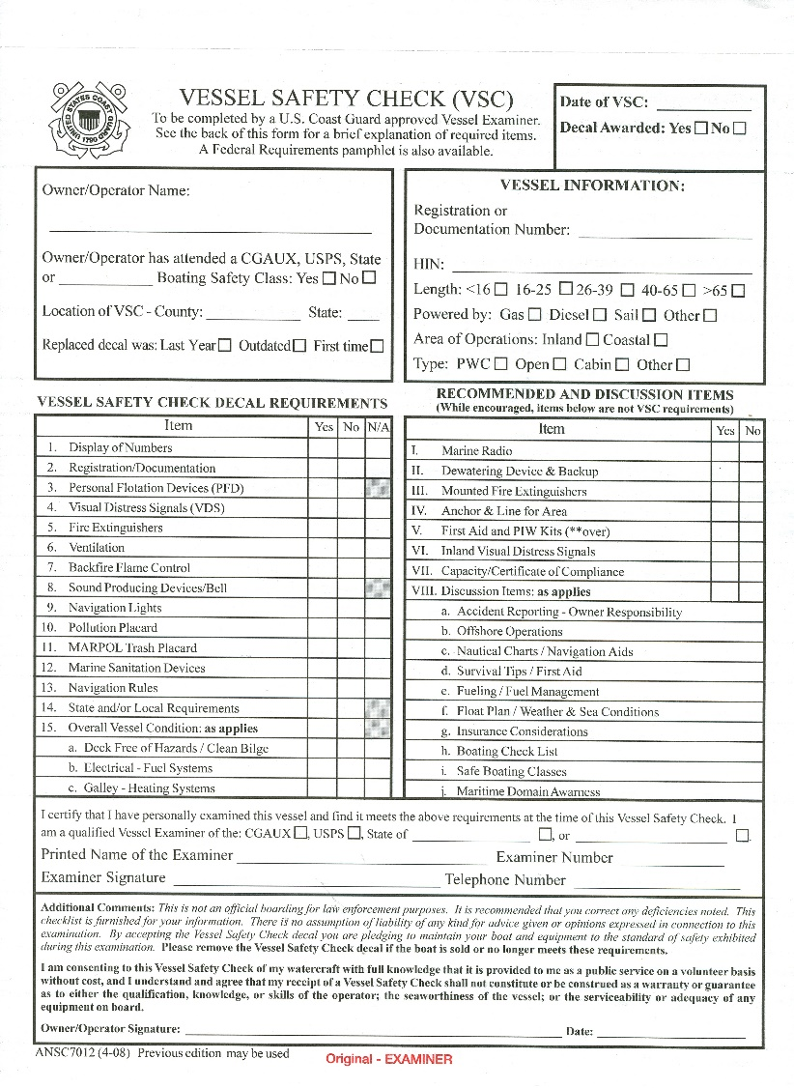
VESSEL SAFETY CHECK FORMS
PADDLE
BOATS
REGULAR
BOATS

Slide 5
Duties, Requirements & Procedures
Vessel Examiners who routinely perform inspections on vessels other than Paddle Crafts should incorporate the same philosophy when inspecting Paddle Crafts.
Paddle Craft inspections can be challenging for Examiners unfamiliar with the craft.
Paddle Craft operators may be less receptive to recommendations and good safety practices for a Paddle Craft if they sense a lack of knowledge of an Examiner of their craft.
Vessel Examiners should learn the terminologies and practices that are specific to Paddle Crafts to gain operators’ confidence.
Vessel Examiners that have never operated a Paddle Craft should consider learning about the different types of Paddle Crafts.

Slide 6
Conducting a Paddle Craft Vessel Safety Check
Vessel Safety Checks are organized into five sections:
Information about the owner or operator (Section I)
Information about the Paddle Craft (Section II)
Mandatory equipment requirements (Section III). These requirements MUST be met to qualify for a Vessel Safety Check decal.
Recommended equipment for Paddle Crafts used in open waters (Section IV)
Other Recommendations provided to the owner/operator (Section V)
Note: Items listed in Section IV and V are recommended but not required

Slide 7
Conducting a Paddle Craft Vessel Safety Check
The Vessel Examiner should ensure that the boater is aware of the regulations and good practices that can help avoid accidents, personal injury, or death.
The Vessel Examiner should recommend that the Paddle Craft operator take a targeted Paddle Craft course such the Auxiliary’s Paddle Sport America, the Power Squadrons’ Paddle Smart seminar, the course offered by the American Canoe Association or any other courses that are offered.

Slide 8
Conducting a Paddle Craft Vessel Safety Check
Section I: Owner/Operator Information
Since most Paddle Crafts do not require state registrations, it is important that the owner/operator’s name be recorded in Section I.
Question the individual if he/she has attended any skill classes such as paddling strokes, rescues, exit and re-entry, and/or safety equipment. If not, recommend that they do so.

Slide 9
Conducting a Paddle Craft Vessel Safety Check
Section II: Paddle Craft Information
If available, all the items in Section II should be entered.
Hull Identification Number (HIN) might not be etched into the hull such as stand-up paddleboards. These craft are exempt from HIN requirements.
The check box referring to Kayak, Canoe, Rowboat, Paddleboard, Scull, etc. should have a check made in the appropriate box.

Slide 10
Conducting a Paddle Craft Vessel Safety Check
Section III: Safety Check Requirements
Sound Signaling Device
Paddlers must carry some sort of sound producing device such as a whistle (ideally attached to his or her Life Jacket) or an air horn.

Slide 11
Conducting a Paddle Craft Vessel Safety Check
Section III – Safey Check Requirements
Life Jacket(s)
Requirements are the same as other vessels: one U.S. Coast Guard approved, wearable life jacket for each person aboard the Paddle Craft.
In NY State, children under 12 must wear an approved life jacket at all times. Federal Law requires children 13 must were a Life Jacket.
The above requirements apply to all Paddle Craft, including stand-up paddleboards.

Slide 12
Conducting a Paddle Craft Vessel Safety Check
Section III: Safety Check Requirements
Overall Vessel Condition
Hull & deck sound - Check the hull for leaks and the bulkhead for lines or fittings that need repair or need replacement. If holes are patched with duct tape, vessel will not qualify for an inspection decal.
If Paddle Craft has a skeg or rudder, be sure it is working and fastened securely.
b. Hatch covers - If the craft has any hatch covers, be sure they are in good condition, secure, and fitted properly to keep water out of the hull.

Slide 13
Conducting a Paddle Craft Vessel Safety Check
Section III: Safety Check Requirements
Overall Vessel Condition con’t
c. Deck lines and bungee cords - All lines and bungee cords should be in good condition and secure. They should not be fraying or hanging off the paddle craft. Note that the paddler uses lines to secure equipment, get back into/onto the Paddle Craft if he or she has fallen overboard, and back on the craft if it has capsized, therefore, the lines should be in good condition.
d. Hardware secure and in working order - Most Paddle Craft will easily flip over, therefore, anything that is loose should be secured. Since this type of craft is most always wet, check to see that all hardware is in working condition.

Slide 14
Conducting a Paddle Craft Vessel Safety Check
Section III: Safety Check Requirements
Overall Vessel Condition con’t
e. Bulkhead/Airbags/Flotation - Check for holes and cracks. Some Paddle Craft do not have any bulkheads and instead require the use of airbags or foam blocks at the stern or bow to provide flotation. This type of craft will become unusable or will sink when flooded if the airbags or foam blocks are missing.
f. Paddle/Oars (serviceable) - Check the shaft and blade of paddles and oars to make sure there are no cracks or fractures.

Slide 15
Conducting a Paddle Craft Vessel Safety Check
Section III: Safety Check Requirements
Navigation Lights
When required, lights should be displayed in accordance with the Navigation rules - side lights and a stern light or a flashlight or lantern showing a white light. Be sure they are working.
Visual Distress Signals
A Paddle Craft operating in coastal waters between sunset and sunrise is required to carry visual distress signals suitable for night. This can be a battery powered S.O.S. light or three combination day and night flares.
State and/or Local Requirements
State requirements differ in each state and if the inspected craft does not meet state and/or local requirements, the vessel does not qualify for an inspection decal.

Slide 16
Conducting a Paddle Craft Vessel Safety Check
Section IV: Open Water Recommendations
Pump or Bailer - You need something to get water out of the vessel
Spray Skirt - Piece of watertight material rigged to keep water from entering cockpit in rough seas or while operator is executing a roll
Spare Paddle/Oars - If you lose one of these, you may have trouble getting home or to your destination
Compass/GPS/Navigation Chart - It’s always nice to know where you are and where you are going
Tow line or vessel recovery system
Marine Radio (handheld VHF)/Cell phone/Personal Locator Beacon (PLB) - These must be kept dry. Note: cell phones only operate in limited areas.

Slide 17
Conducting a Paddle Craft Vessel Safety Check
Section V: Other Recommendations
Dressed for immersion/helmet
Although Paddle Craft operators aren’t required to be skilled swimmers, they are urged to improve their swimming ability. In addition, they should wear life jackets. Paddle Craft operators should practice their skills in exiting and entering their craft in all possible weather conditions where they plan to use their craft.
Carry Personal ID on the operator
Float Plan
Tell someone what and when you plan to do and the area you will be in.
Adequate Food & Water/Sun Protection
If operating for long periods in the sun, individuals should use sunscreen and carry appropriate amounts of food and water.

Slide 18
Conducting a Paddle Craft Vessel Safety Check
Section V: Other Recommendations
Assess the risk/good awareness
Operators should check the weather, sea & wind conditions, and boat traffic. They should remain alert to early signs of fatigue and reserve some of their energy for returning home.
In cold weather, paddlers should wear anti-exposure suits or dry suits, complete with hood, gloves, booties and masks when conditions call for them.
High visibility clothing, gear, etc.
Paddlers should be visible to other boaters and ensure that larger vessels will be able to see them relatively easy in rough water, high traffic areas and reduced visibility.

Slide 19
Conducting a Paddle Craft Vessel Safety Check
Section V: Other Recommendations
Appropriate emergency kit
Paddlers should have a First Aid Kit, carry a knife, and carry a repair kit with some basic parts to get them safely back home.
Appropriate self-rescue system/skills
Paddle Craft operators should carry an effective towline or towing system and rescue gear, learn towing and rescue procedures, and practice them often.
Contact information affixed to your craft
List your contact information in a watertight bag affixed to the craft in the event of an accident.

Slide 20
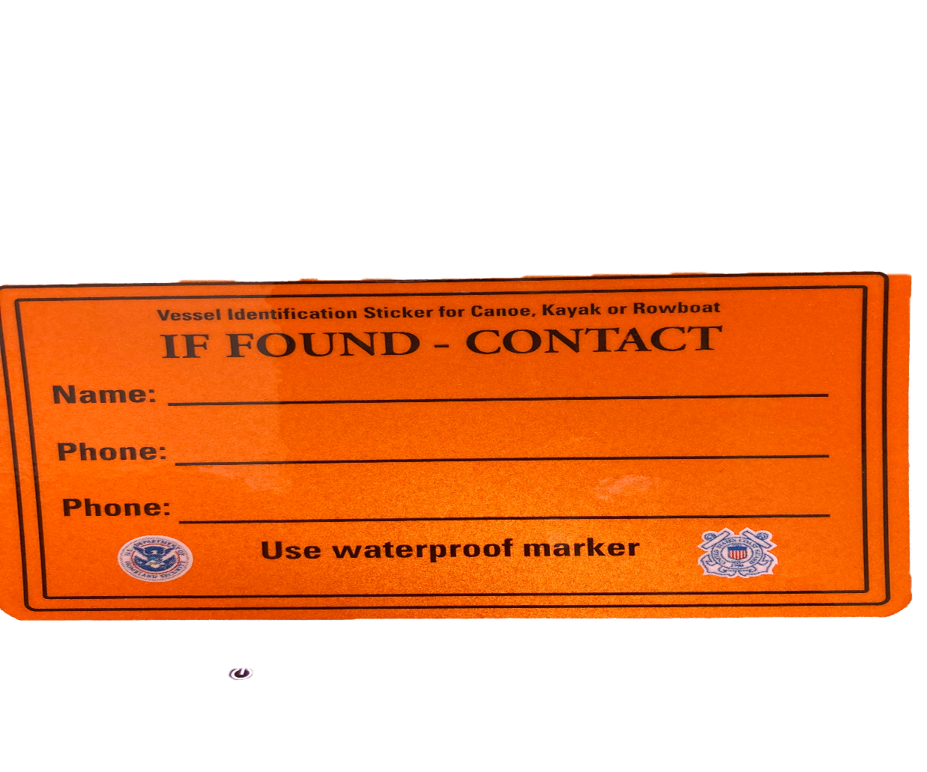
Conducting a Paddle Craft Vessel Safety Check
Section V: Other Recommendations
Contact information affixed to your craft (continue)
For Canoes, Kayaks or Rowboats there is a waterproof sticker that can be affixed to your vessel. The sticker has you Name, Phone number, or your Cell phone number written on it with a water proof marker. If you lose your vessel for any reason the sticker shown below may help you retrieve your vessel. Inspectors should carry the sticker to be distributed if need.

Slide 21
Conducting a Paddle Craft Vessel Safety Check
Section V: Other Recommendations
Accident Reporting
This is the responsibility of the operator of the craft. The dollar amount for reporting an accident varies from state to state. Vessel Examiners should become familiar with Accident Report requirements in their state.
Anchor light (if applicable)
When required, an all-around white light must be displayed in accordance with the Navigation Rules.

Slide 22
THANK YOU FOR VIEWING THIS PRESENTATION

